Slide 1
Workshop 2: RECAP of yesterday
ML1

Slide 2
Goals of yesterday
linear regression as very important algorithm for your toolkit
for continuous variables (as opposed to classification)
why math? To get intuition
when using a library, understanding and tweaking the behavior
path of evolution: linear regression -> logistic regression -> neural networks
understand machine learning
learn python/numpy/pandas

Slide 3
Machine learning
visualize/understand the data
(data preparation)
choose a model
straight line or polynomial
parameter learning
fitting the model to the data by means of finding parameter values
define a cost function
minimize the cost
how? gradient descent algorithm (aka optimizer)
gradient descent update rule: iteratively find the minimum cost
every iteration step uses the complete data set

Slide 4
What did we do yesterday?
1 feature -> univariate linear regression
multiple features -> multivariate linear regression
using a neural network consisting of 1 neuron to do linear regression
linear regression using a library (how you do it in practice)

Slide 5
Workshop 2: logistic regression
ML1

Slide 6
Why learn about logistic regression?
Because …
we want to do classification
linear regression is not usable for classification
there’s a logical evolution from linear regression to logistic regression to neural networks

Slide 7
Hands-on assignments
Hands-on 1: Logistic regression
Hands-on 2: Bias, overfitting and regularization

Slide 8
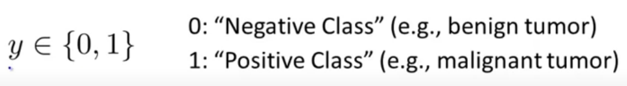
Classification
binary classification:
email: spam or not spam
titanic: survived or deceased
tumor: benign or malignant

Slide 9
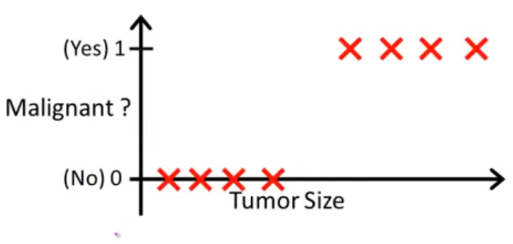
attempt: linear regression
threshold classifier output of h(x) at 0.5:
>0.5 -> predict y=1
<0.5 -> predict y=0
0.5
decision boundary

Slide 10
attempt: linear regression
add more data
2nd problem:
h(x) can be > 1 and < 0
0.5
decision boundary
moved to the right!

Slide 11
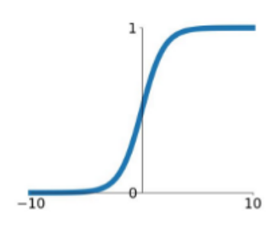
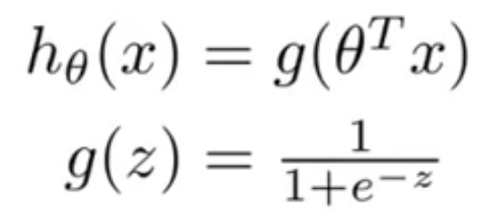
Hypothesis for classification: sigmoid function
we want: 0<= h(x) <= 1
aka activation function (Keras)
0.5

Slide 12
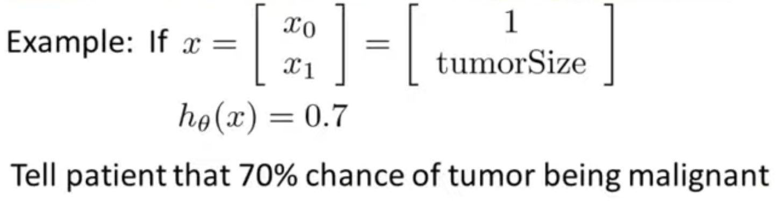
Hypothesis for classification
interpretation: h(x) is estimated probability that y=1 on input x

Slide 13
Decision boundary
Suppose predict “y=1” if h(x) >= 0.5 ➔ theta @ X >= 0
Suppose predict “y=0” if h(x) < 0.5 ➔ theta @ X < 0

Slide 14
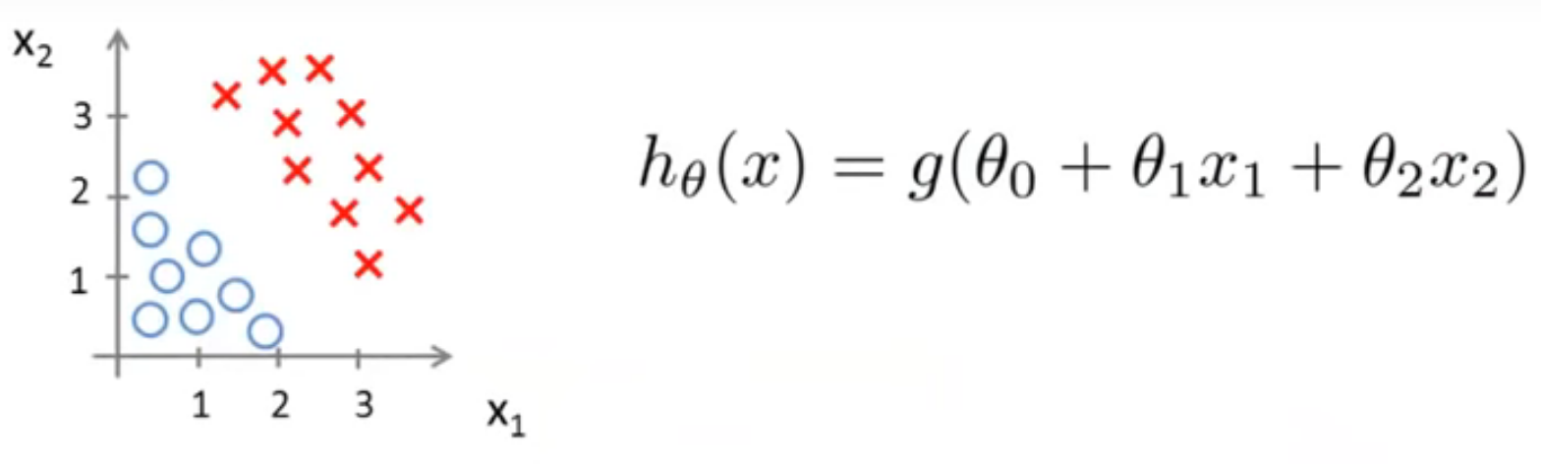
Decision boundary
theta = [-3, 1, 1]
predict “y=1” if -3 + x₁ + x₂ >=0

Slide 15
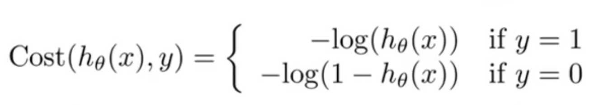
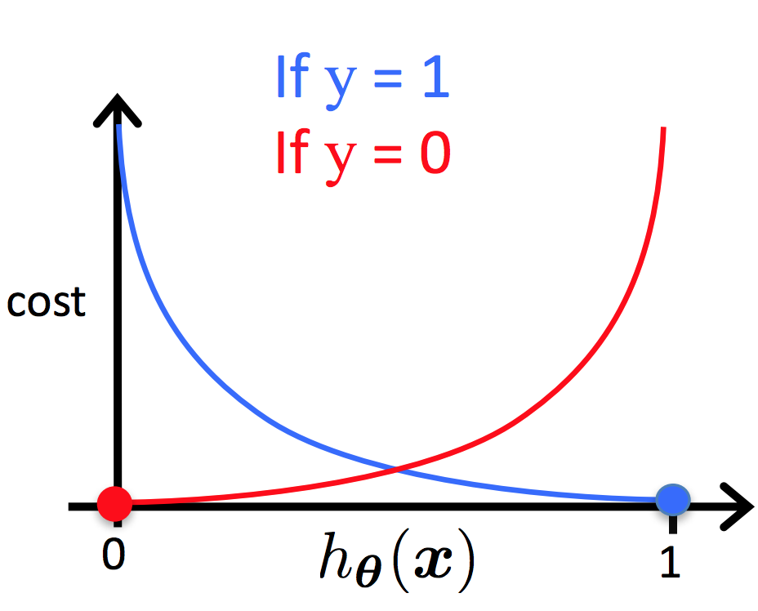
Cost function for logistic regression

Slide 16
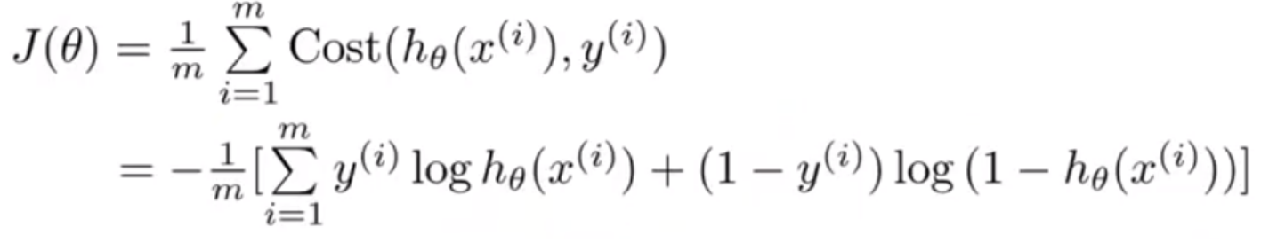
Simplified cost function for logistic regression

Slide 17
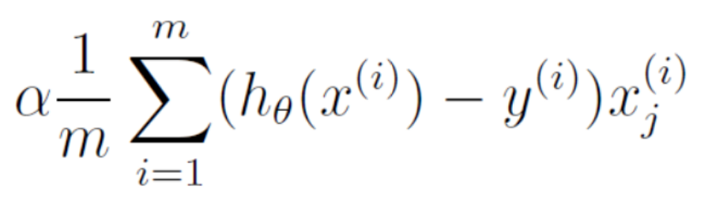
Gradient for cost function
Same as for linear regression!!

Slide 18
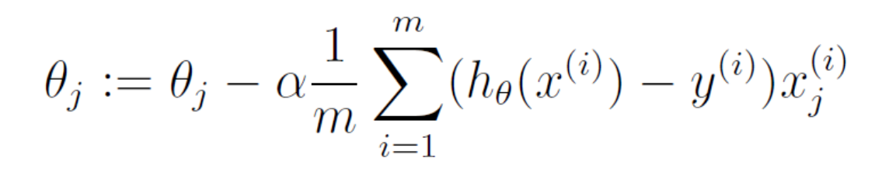
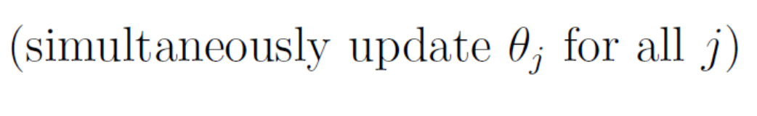
Gradient descent update rule
Same as for linear regression!!

Slide 19

Now … python
We’re done with the maths!
What’s left is just a matter of translating to python

Slide 20
Workshop 2: bias, overfitting and regularization
ML1

Slide 21
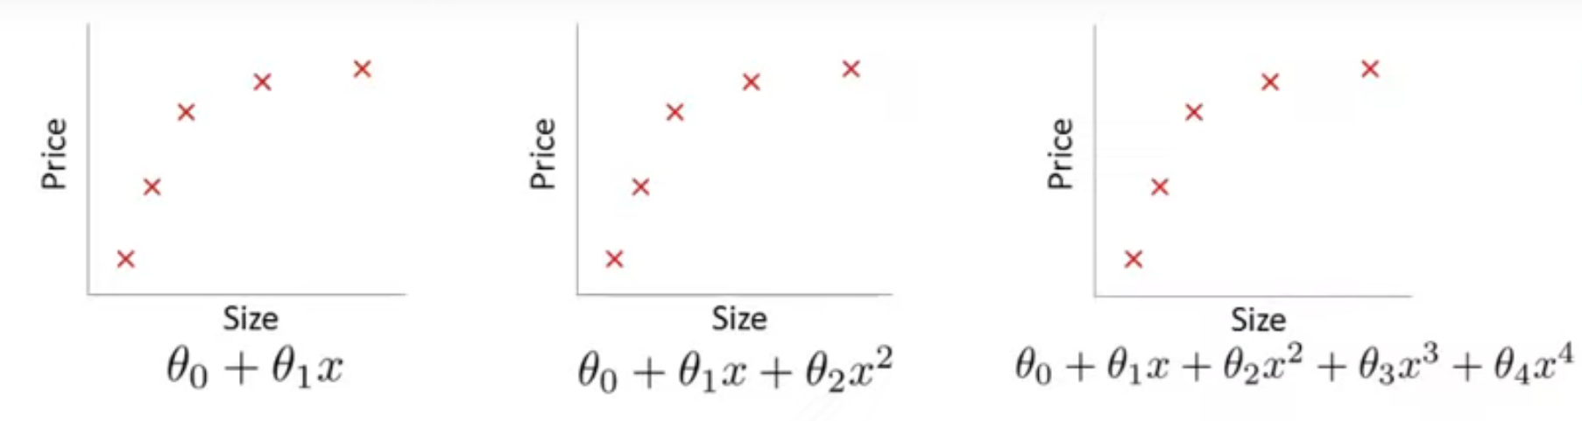
overfitting for linear regression
high bias
(underfit)
just right
high variance
(overfit)

Slide 22
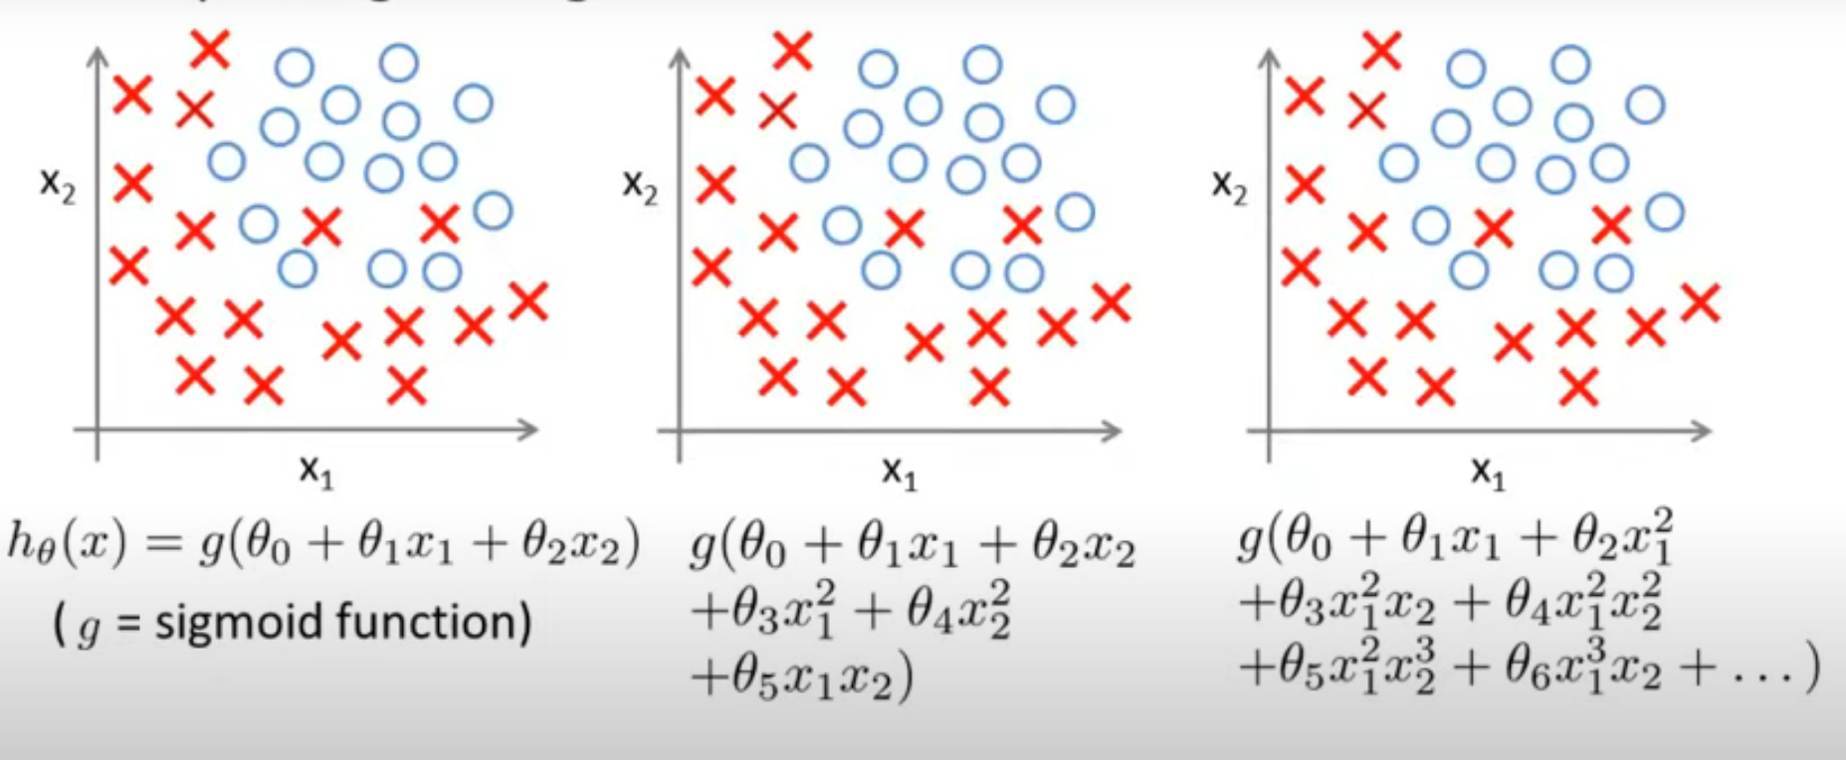
overfitting for logistic regression
high bias
(underfit)
just right
high variance
(overfit)

Slide 23
Overfitting (aka high variance)
detecting overfitting:
Plotting
With many features, plotting the data is not possible any more to see if overfitting occurs!
Dividing your data into training data and test data
the model performs very well on the training data
the model performs bad on the test data
causes:
(too) many features
real ones ore constructed ones like polynomials
(too) few data samples
(too) flexible hypothesis (model)
countermeasures:
feature selection:
reduce number of features by only selecting the features that really matter.
This can be done manually, or automatically.
Automatic methods: correlation (heat map), dimensionality reduction (PCA), .... More info here. Of course, by ignoring features, important information might be lost!
artificially increase the number of training samples.
regularization:
reducing the values of the theta’s

Slide 24
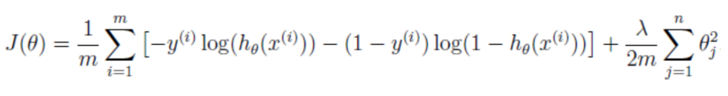
Regularization for logistic regression: adapted cost function
keep all the features, but reduce their flexibility to fit the training data

Slide 25
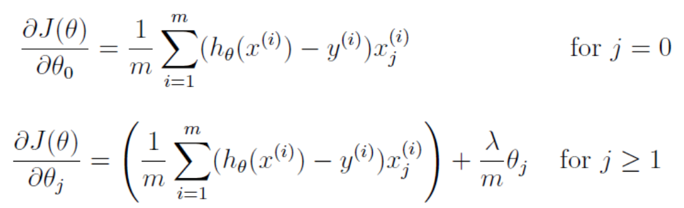
Regularization for logistic regression: adapted gradient

